Slide 1


Slide 2
Oracle SQL Developer Data Modeler
An Introduction

Slide 3







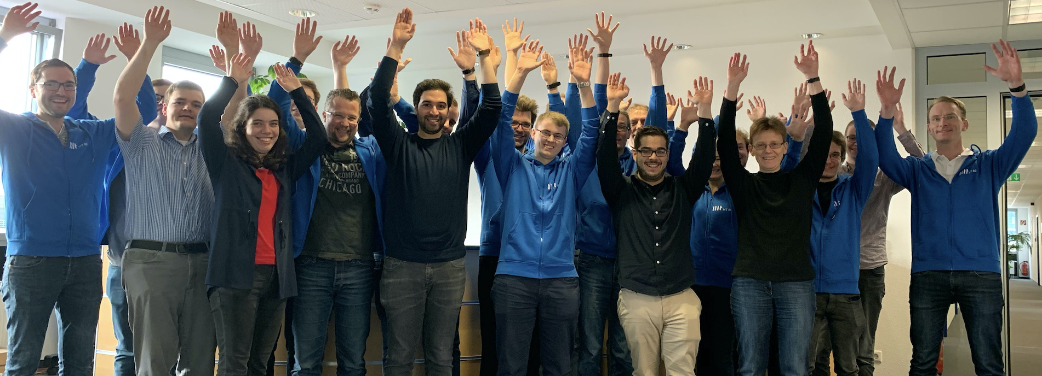





About MT AG
Founded
1994
Privately-Owned Corporation
36 Mio. Euro Revenue in 2020
>100 Active Clients
Head Office
Ratingen
Branch Offices
Frankfurt am Main
Cologne
Munich
Hamburg
280 Employees
45 APEX Experts
Oracle
Platinum Partner
Microsoft
Gold Partner
Your partner for digital change
Individual IT solutions from one source
Top Company for Trainees & Students
Non-Proprietary
Cross-Industry

Slide 4

About Me
Principal Consultant APEX at MT AG
APEX Developer since first public release ( 2004 called HTMLDB 1.5 )
Oracle Developer since 2001 (SQL, PL/SQL, OWB)
Host of Oracle APEX Meetups Frankfurt
Moritz Klein

Slide 5
Oracle SQL Developer Data Modeler
Graphical Tool to create data models (and more)
Integrated into SQL Developer
Also available stand-alone
Contains a lot of functionality
Often complex and hard to understand
Let’s try to change that

Slide 6
Agenda
General Configuration
Design Defaults
Forward- vs. Reverse-Engineering
Helpers - Keeping it manageable

Slide 7
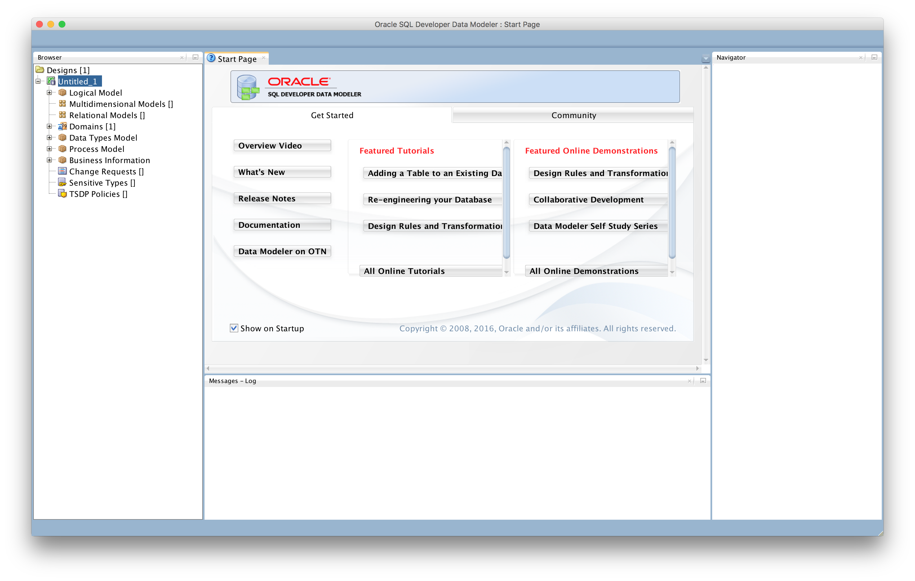
General Configuration – First Start

Slide 8
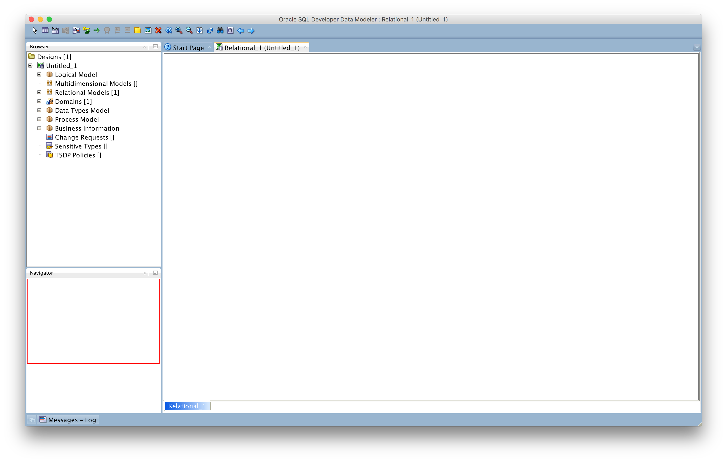
General Configuration – Space for the Model
Drag & Drop with Dropzones
Minimize Log
Tabs within Dropzones
Maximize real estate for your model

Slide 9
General Configuration – Language Setting
Language derived from OS
Not changeable within DataModeler
Example to force English
AddVMOption –Duser.language=en
~/.oraclesqldeveloperdatamodeler/$(version)/product.conf (macOS)
Somewhere in %APPDATA% on Windows
Other JVM Options can be set here also
Forcing specific folders for settings
Managing allocated memory

Slide 10
General Configuration – Preferences to check
Preferences
Data Modeler
DDL
Model
Relational
Physical
Environment

Slide 11
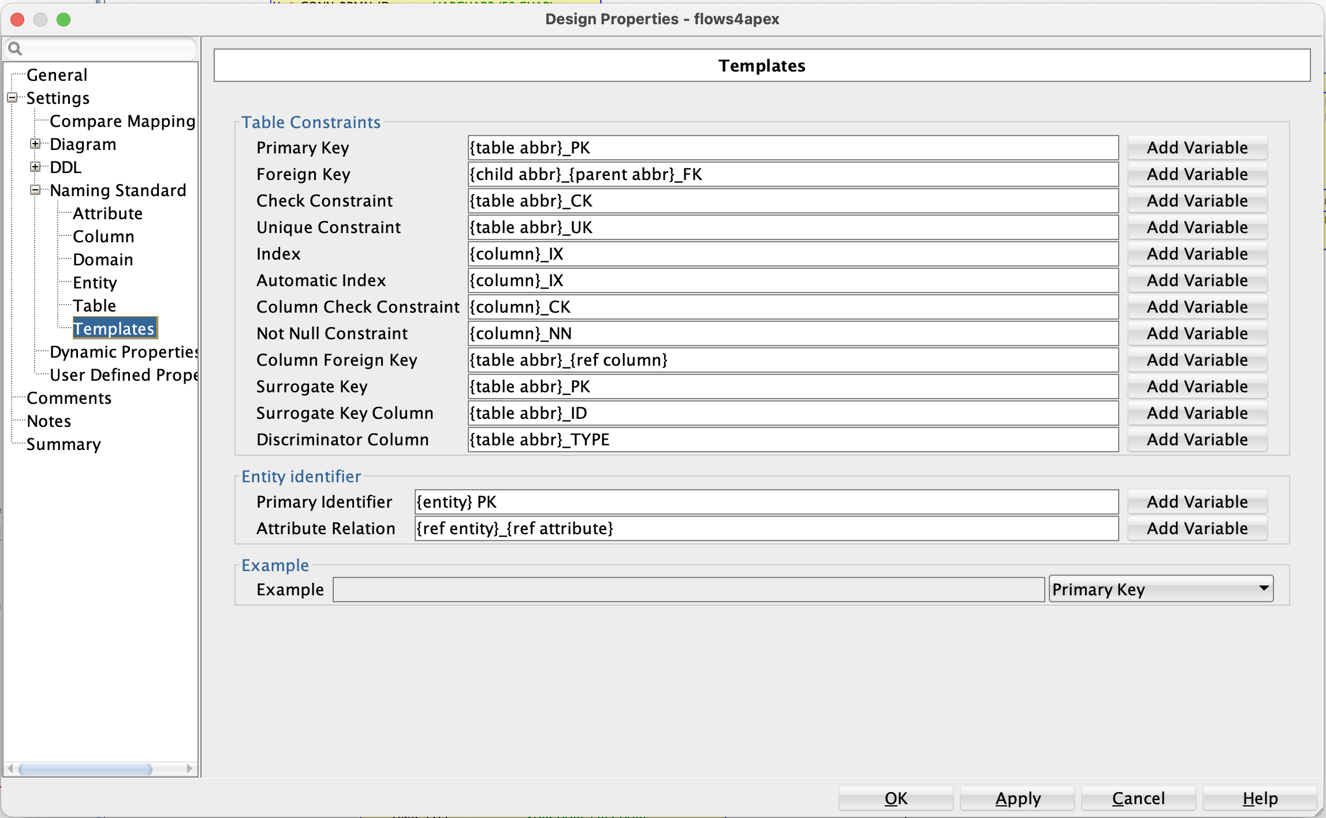
Design Defaults – Configuring Templates
Automatic Naming
Adapt as needed
Define once
Export
Reuse

Slide 12



Smurf or Minion?

Slide 13
Forward Engineering
Live Demo

Slide 14
Reverse Engineering
Live Demo

Slide 15
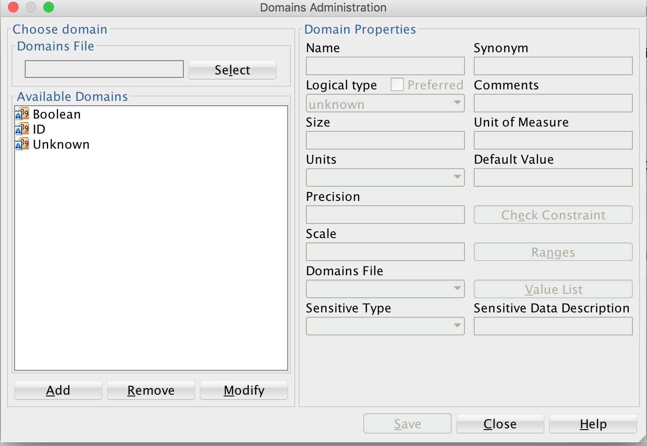
Helpers - Domains
Consistency
Global Changes
Define Types
Boolean
ID column
Change Date
Change User

Slide 16
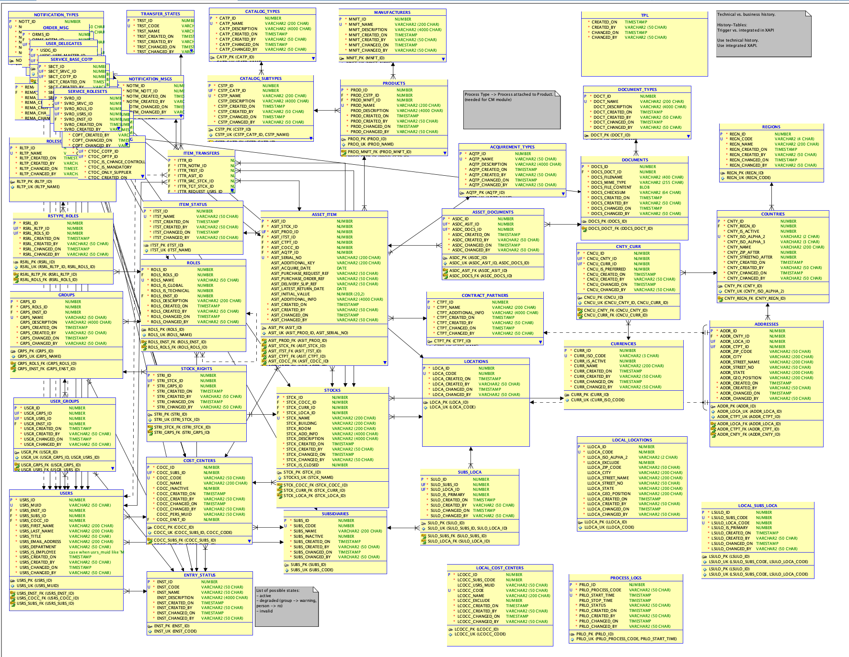
Helpers - Subviews
Full Model quickly cluttered
Often too big to see
Hard to keep tidy
Subviews help

Slide 17
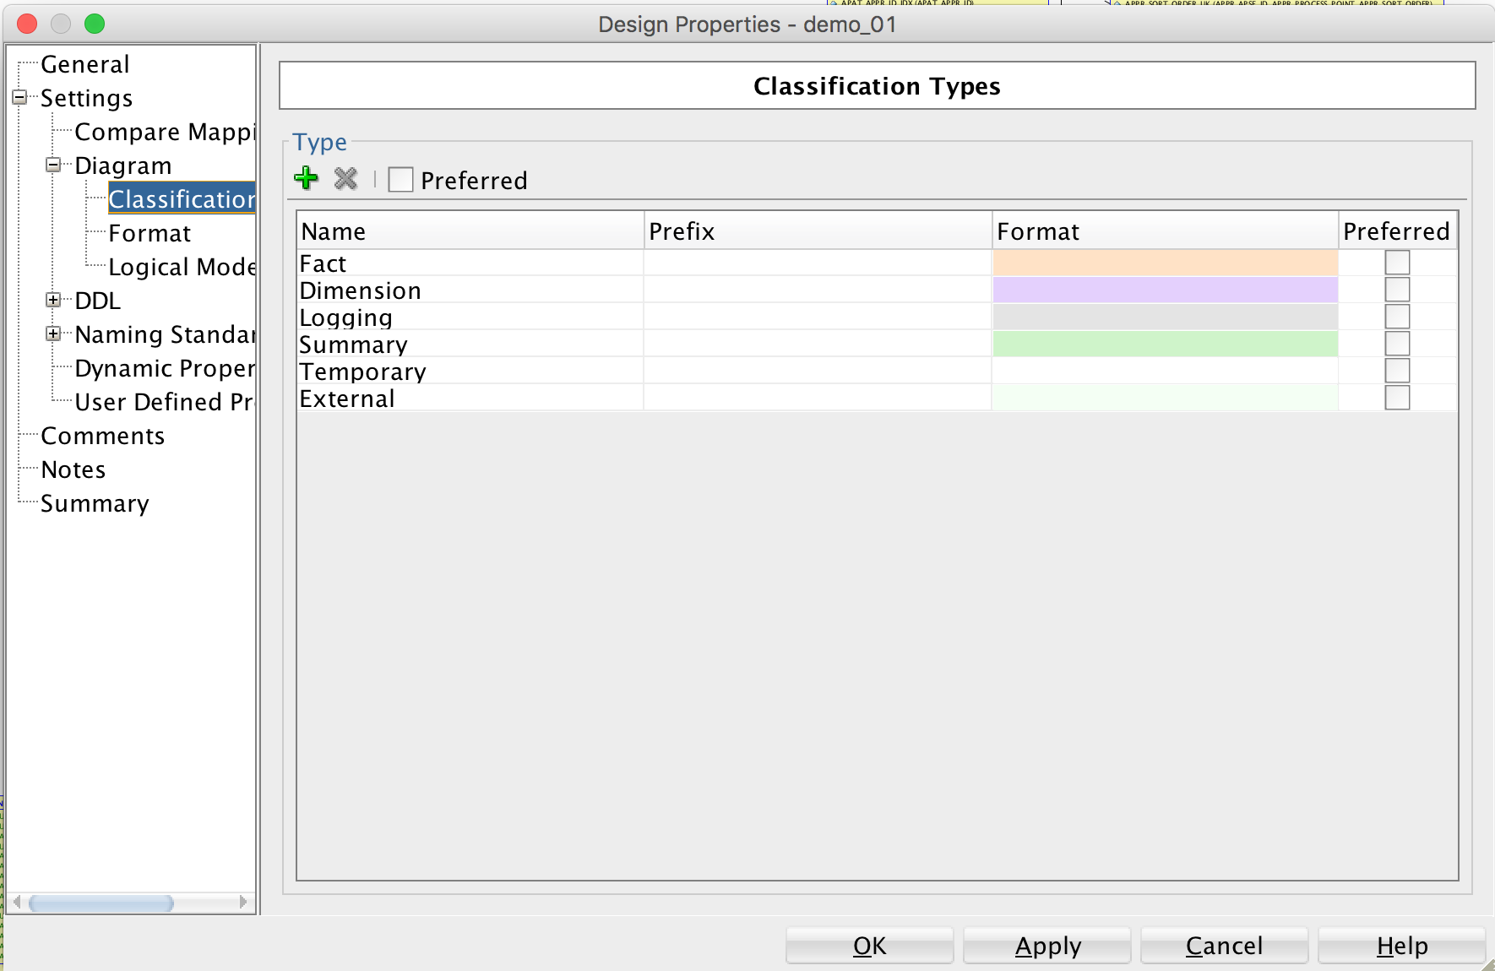
Helpers – Classification Types
Distinguish different Types
Using
Color
Prefix

Slide 18
Demo – Using Everything
Live Demo

